Slide 1
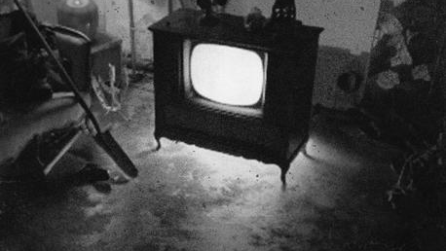
Spooky TV and Movie Theme Songs

Slide 2


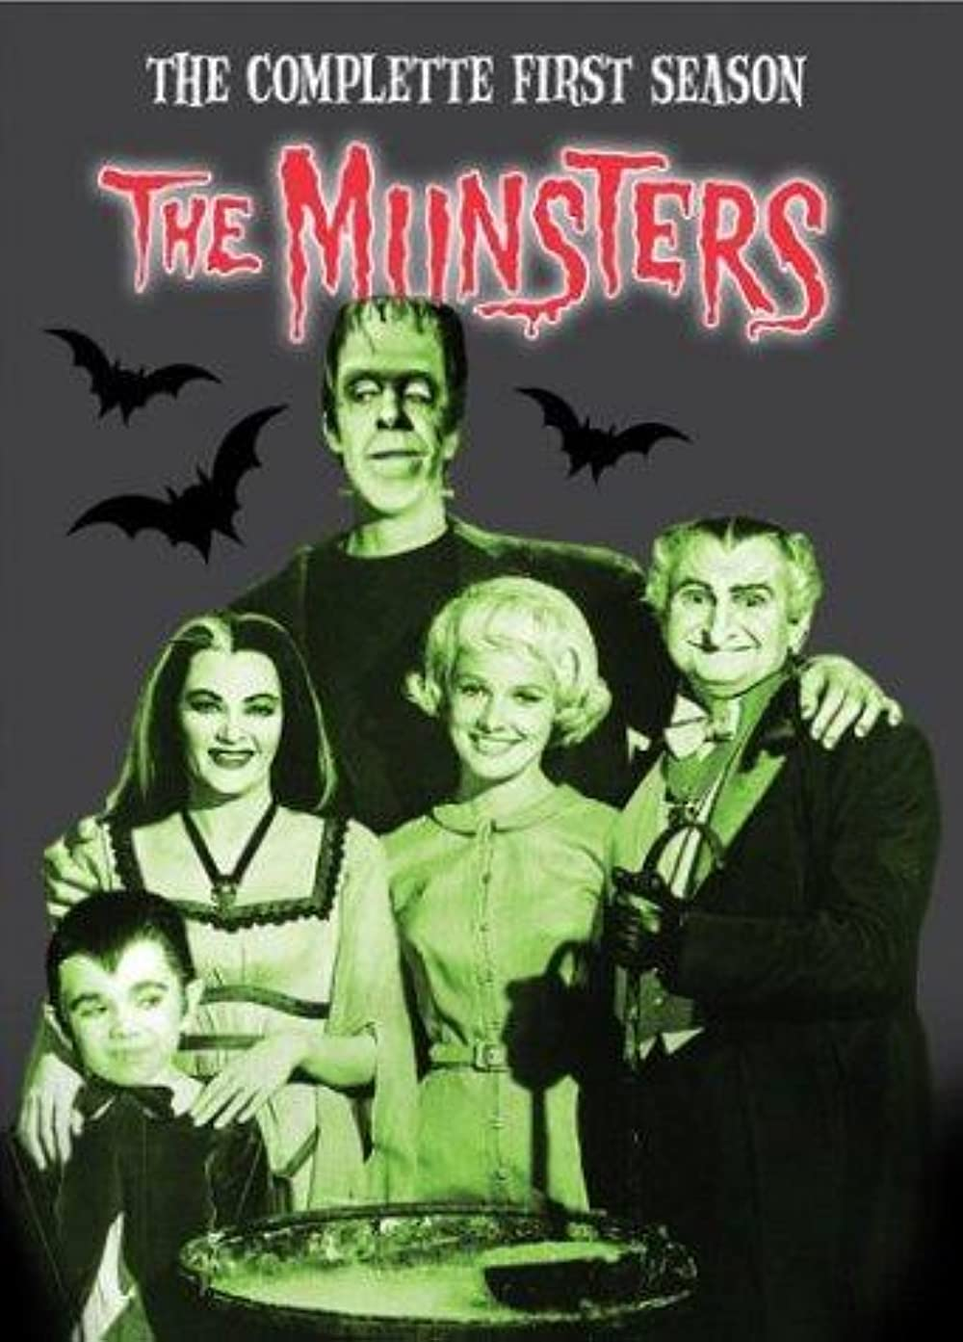
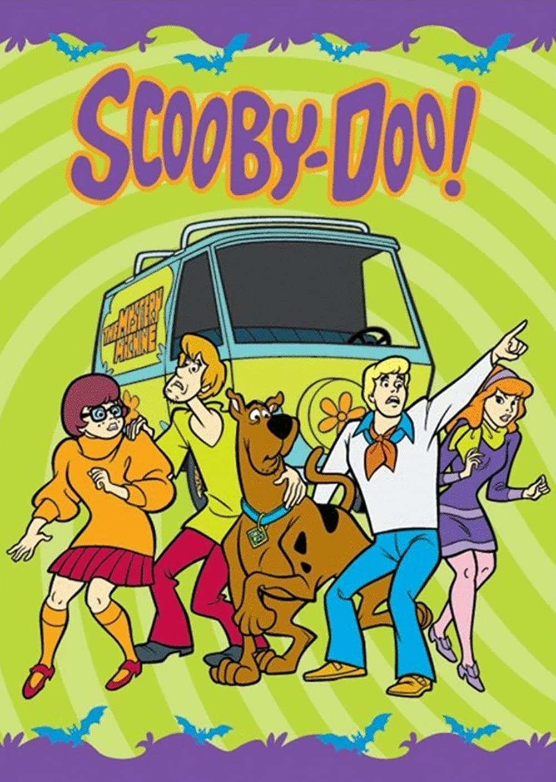
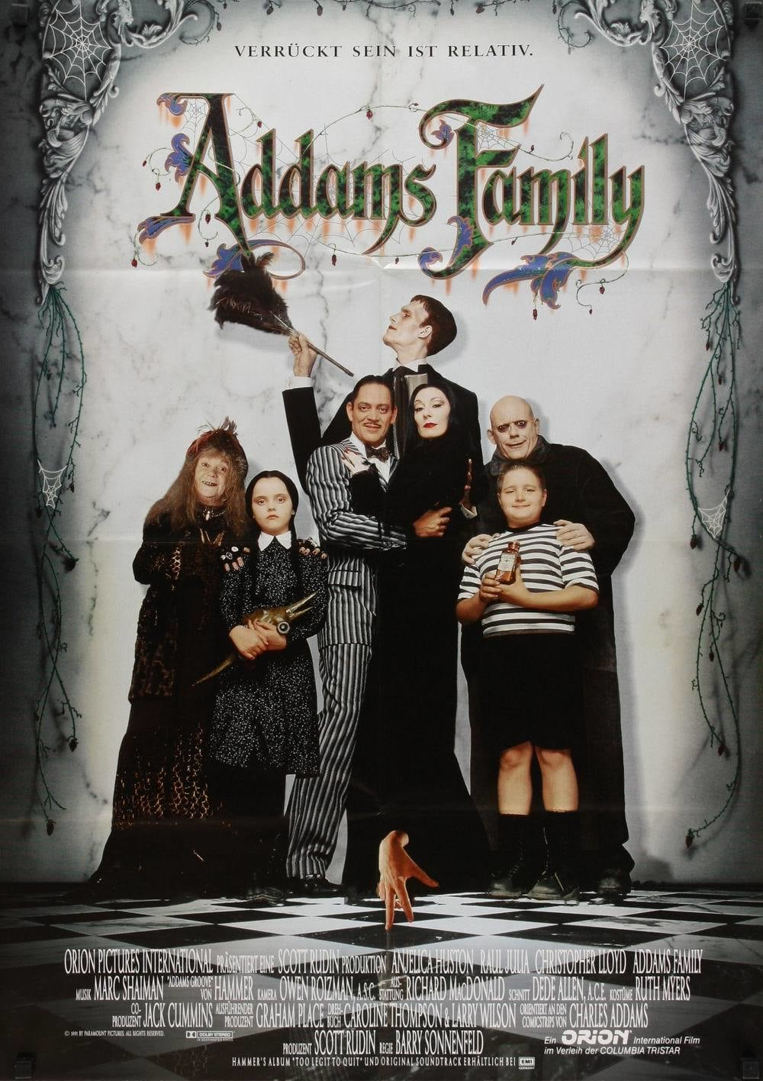
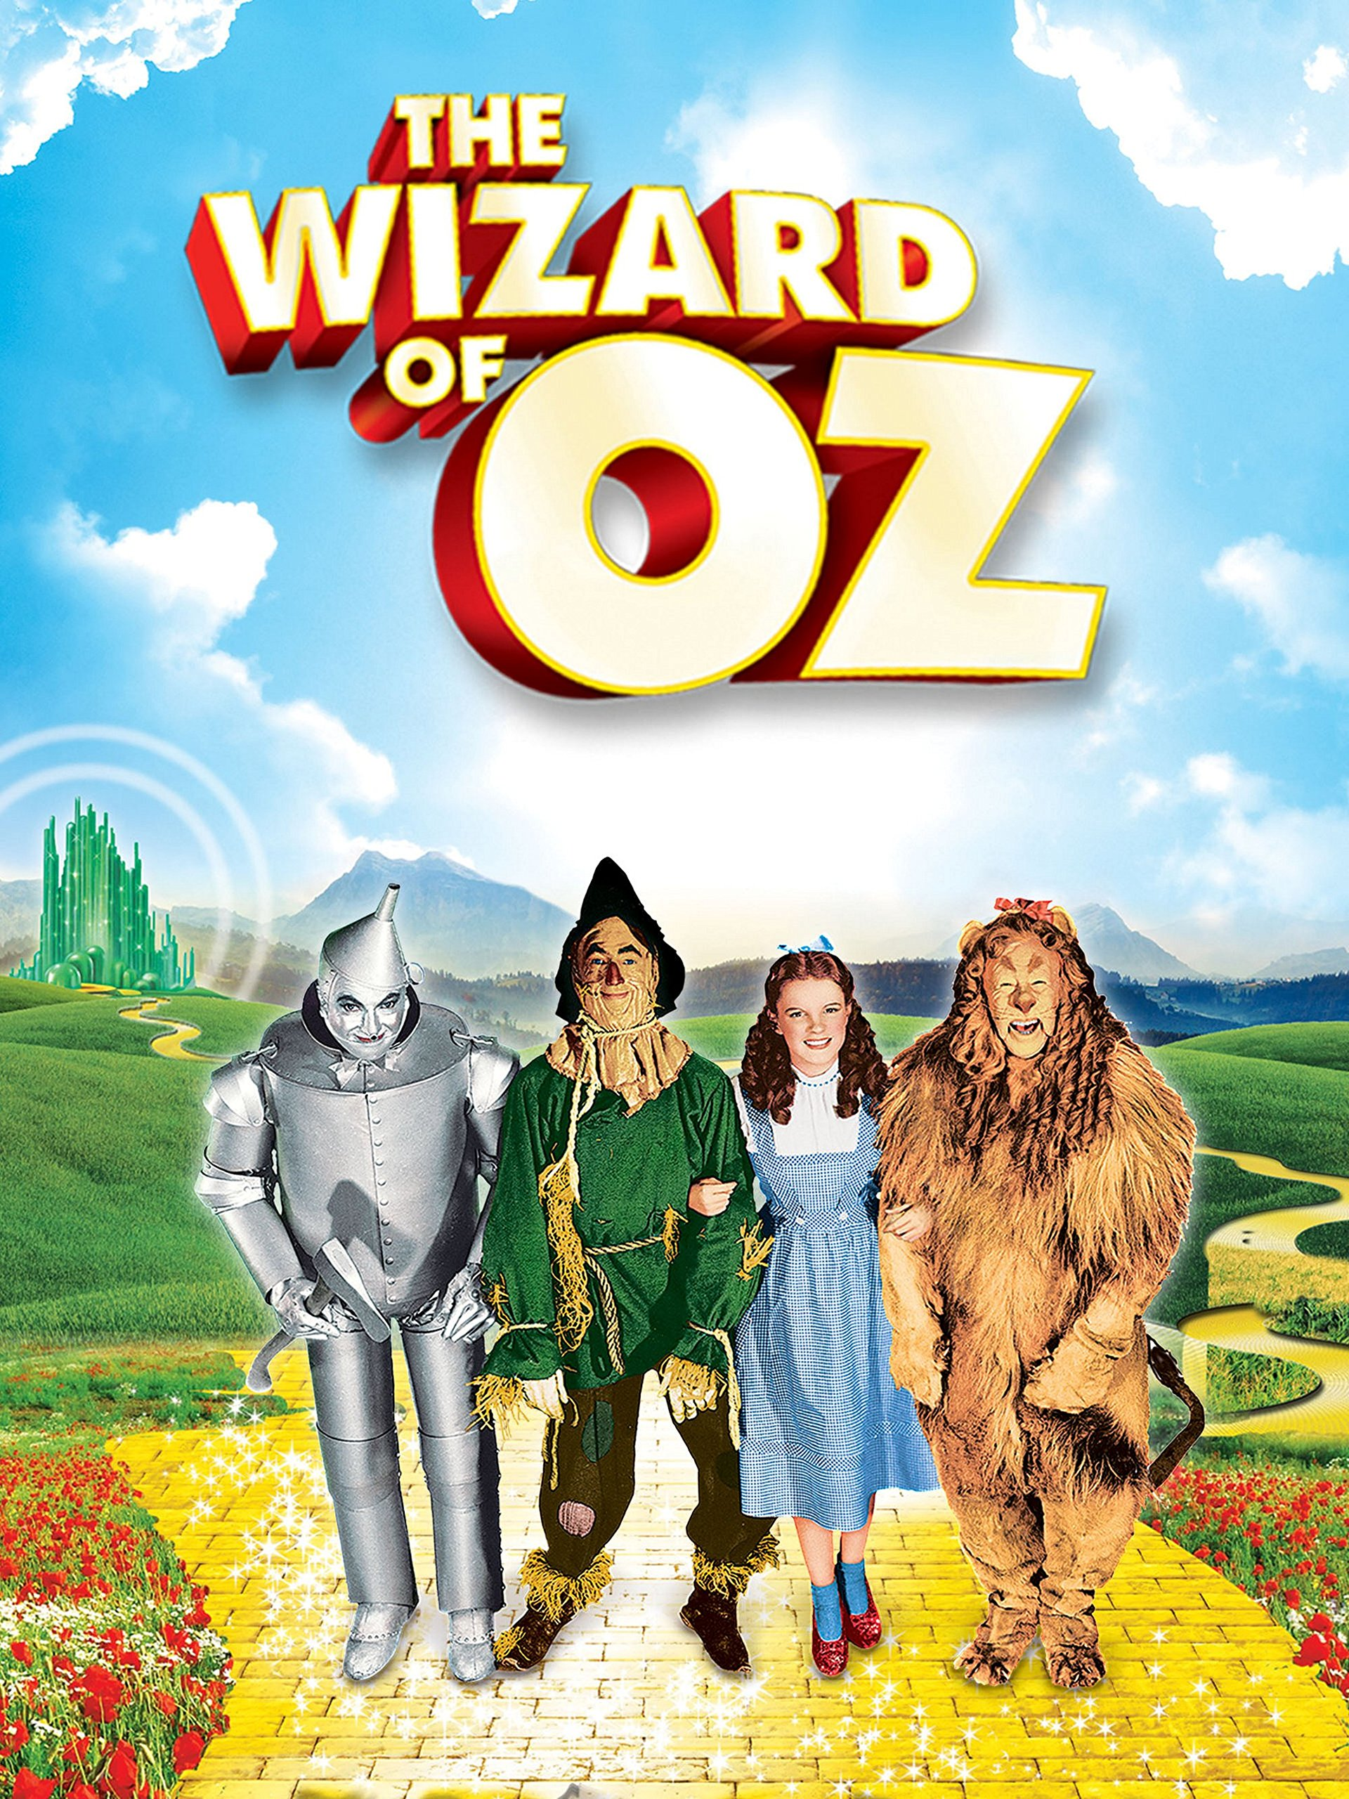
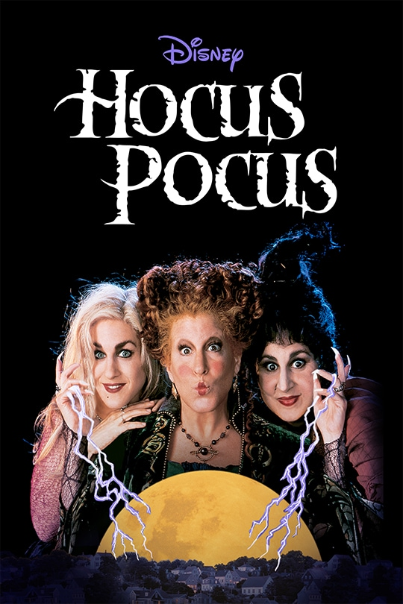


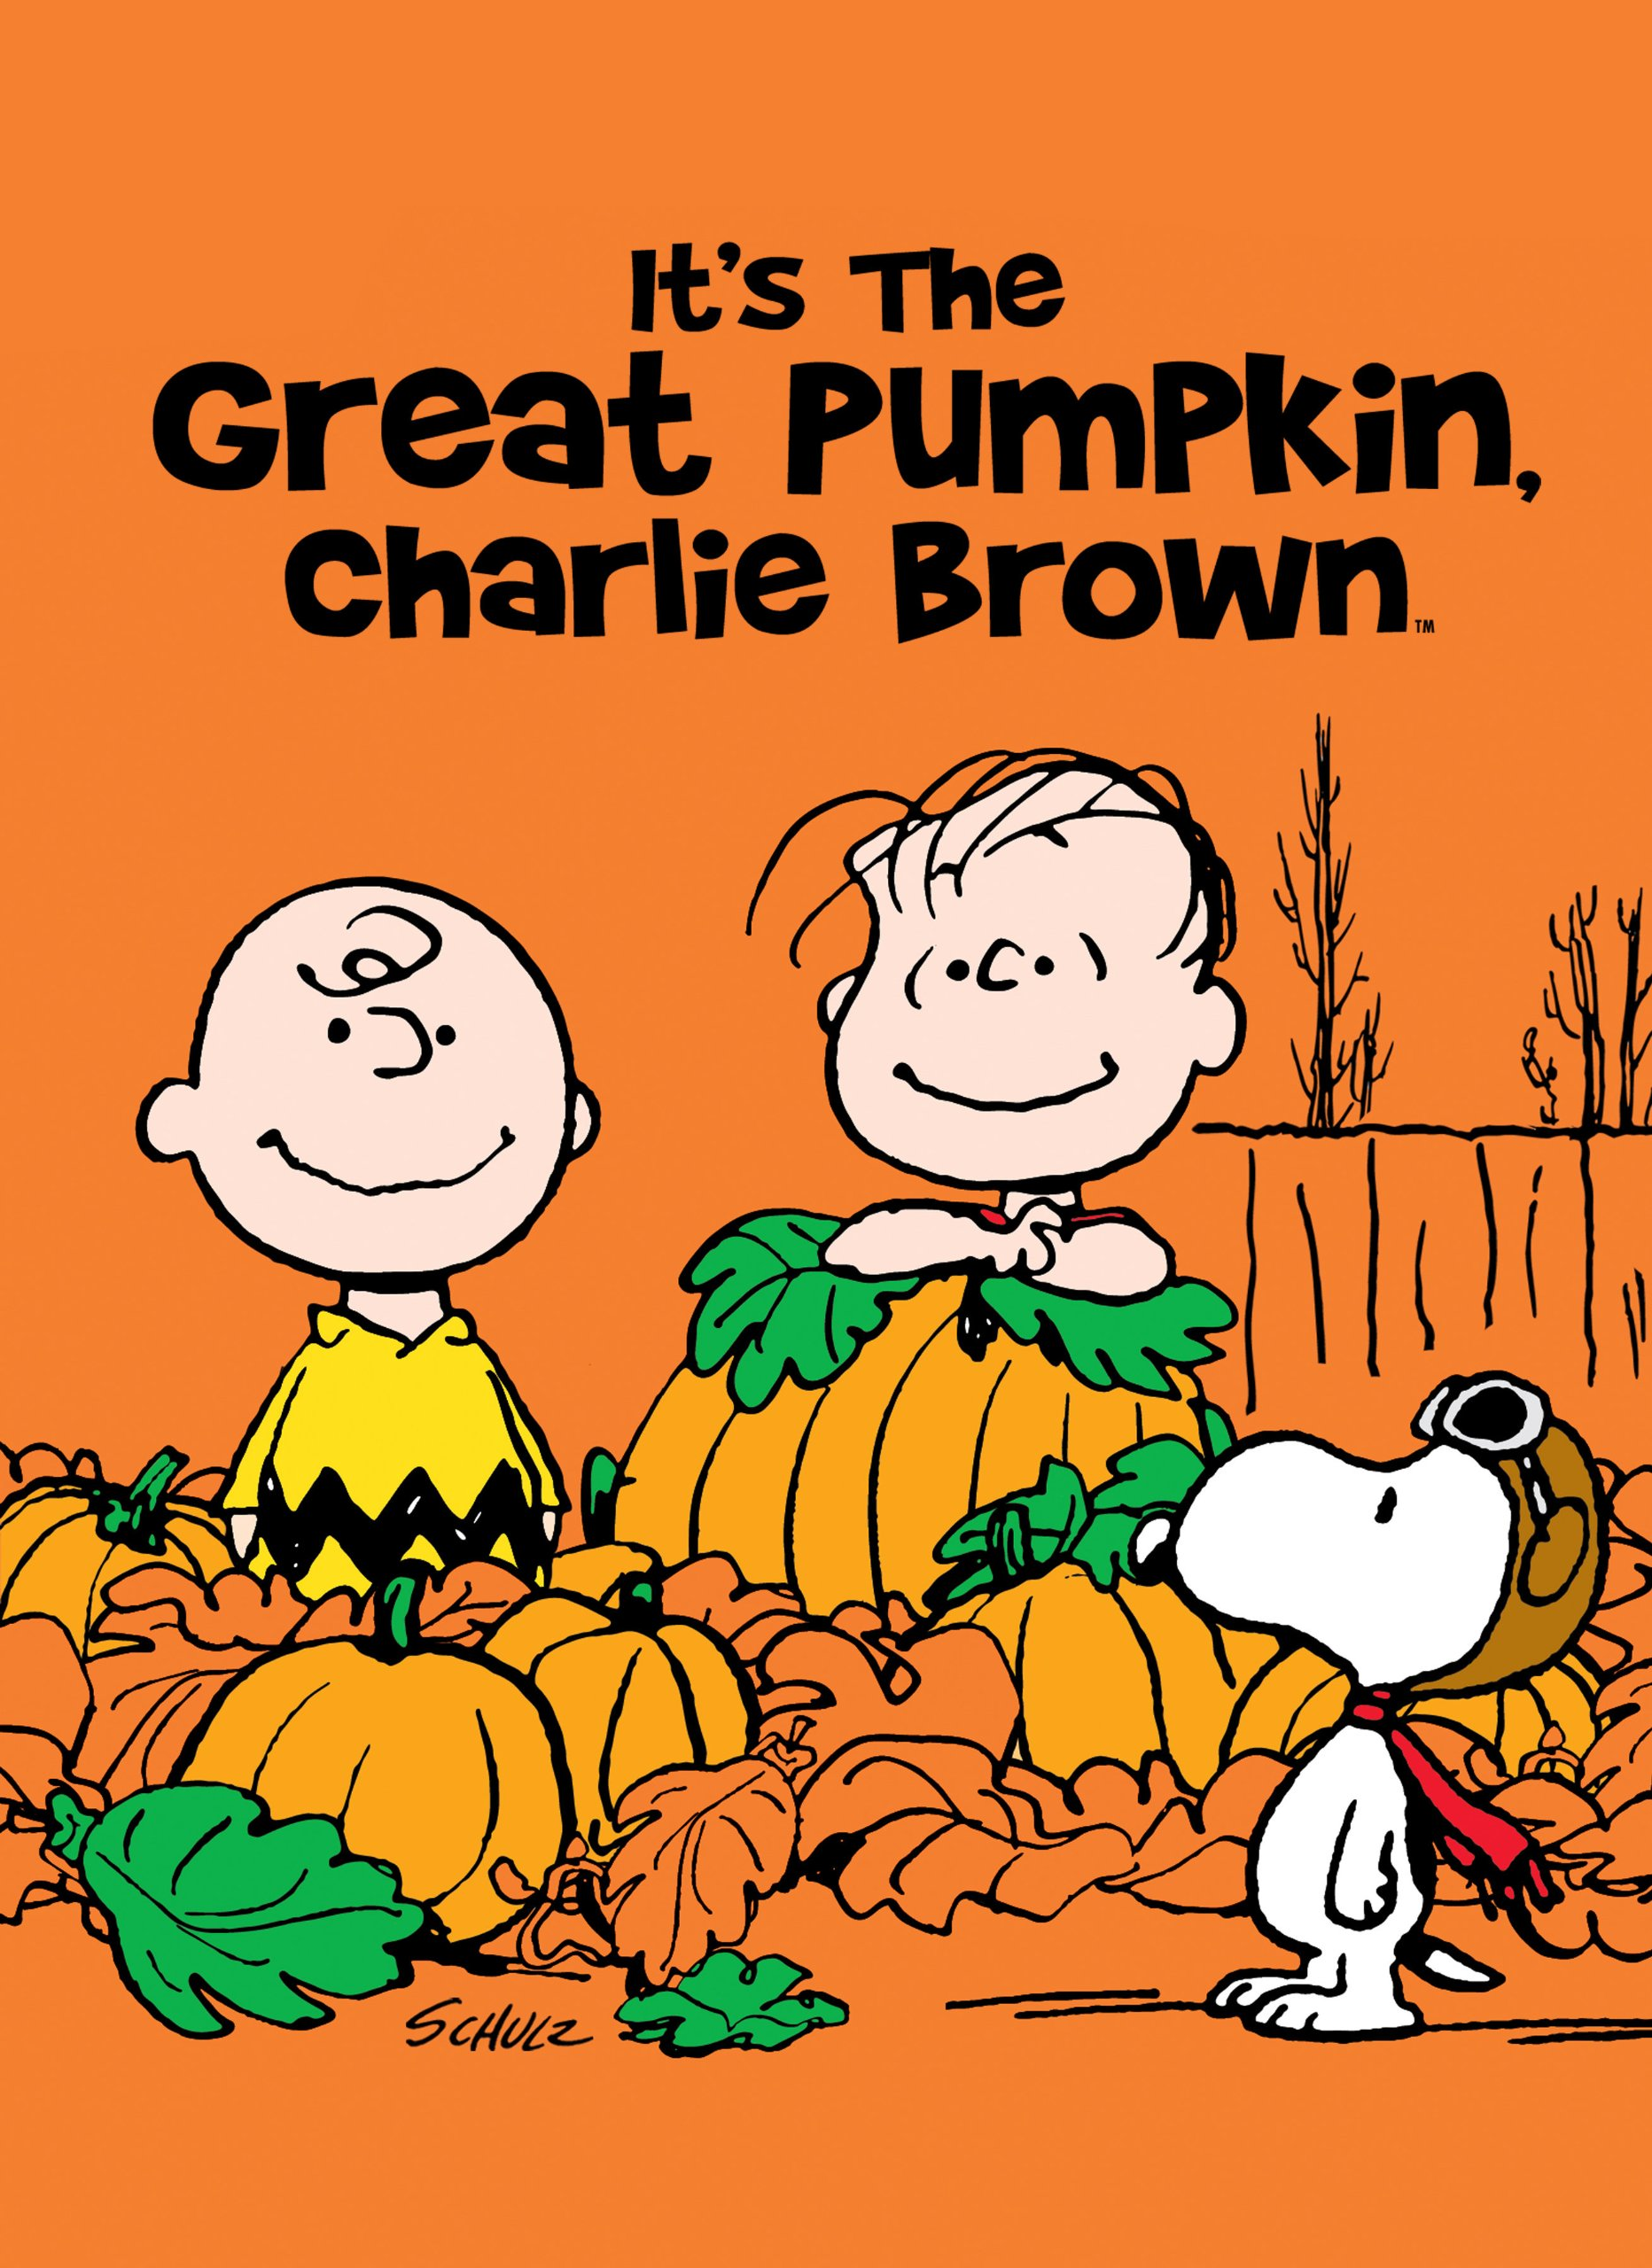
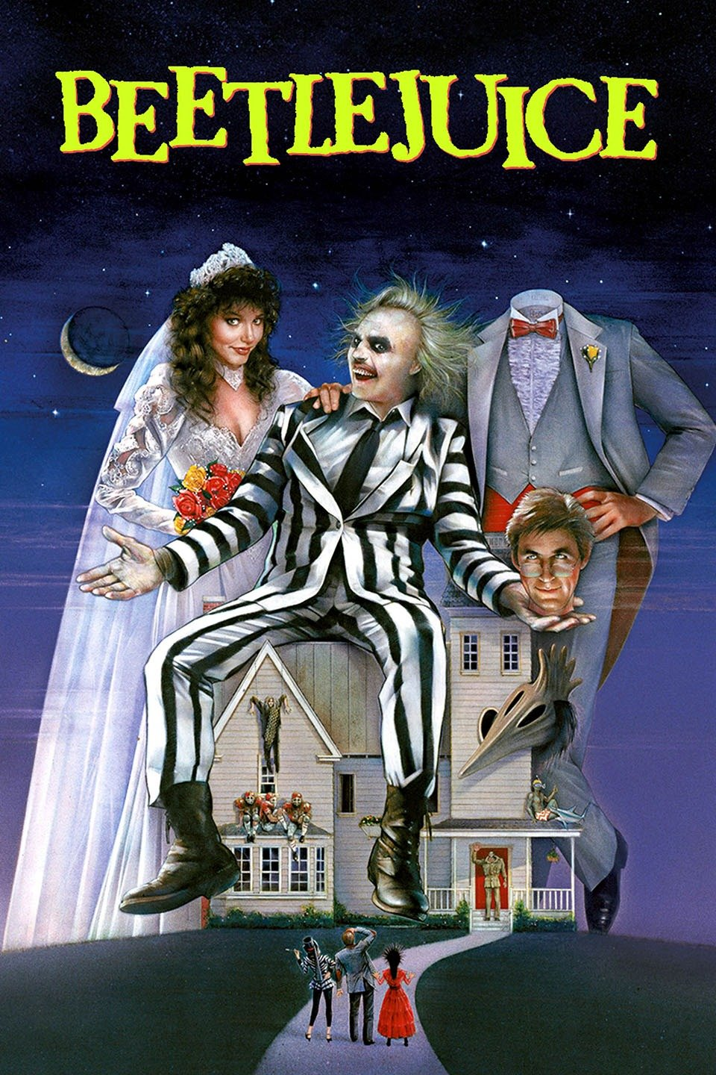
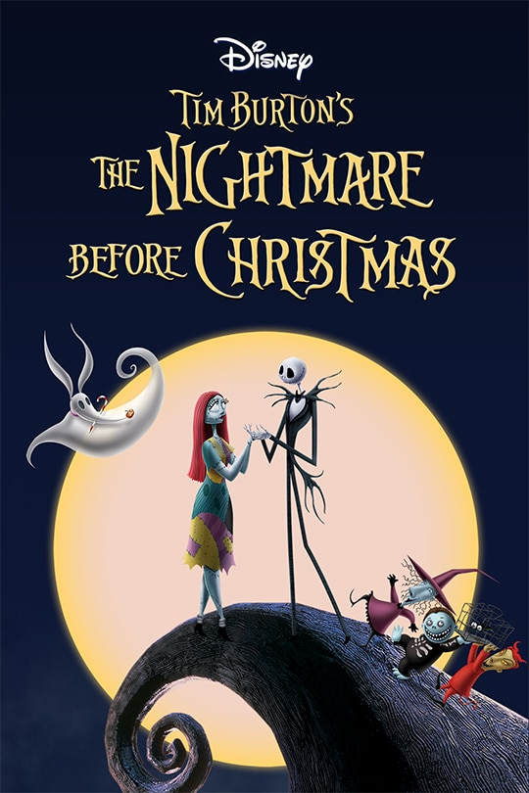
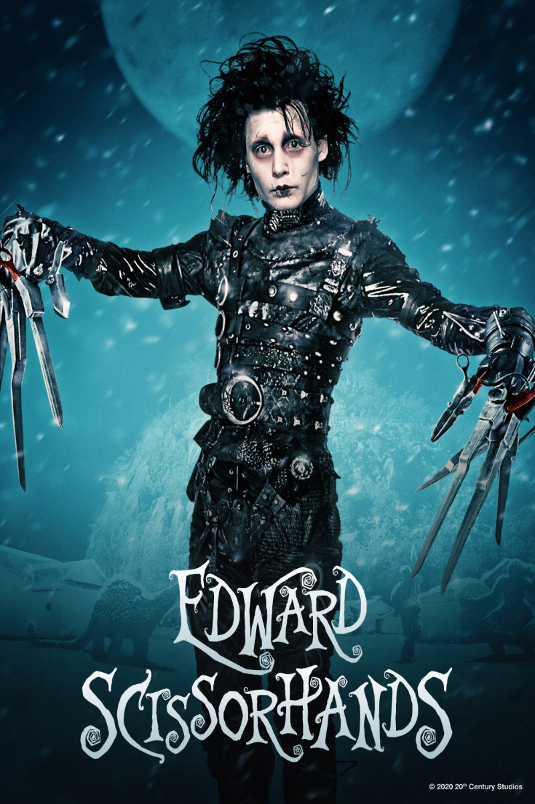


Slide 3
Spotify Playlist
Play the theme song from one of the TV shows or movies.
Have participants guess which show it is from. Once they have guessed correctly, click the pumpkin next to the corresponding picture to cover it up.
Continue until all songs have been guessed.
Can add element of “strikes”. Team goal is to only get 3 “strikes” or incorrect answers.
https://open.spotify.com/playlist/26F9cUjXIyNzlXii7IuxRq?si=5XrVkgQqQlmF_1sEpX7CjQ

