Slide 1
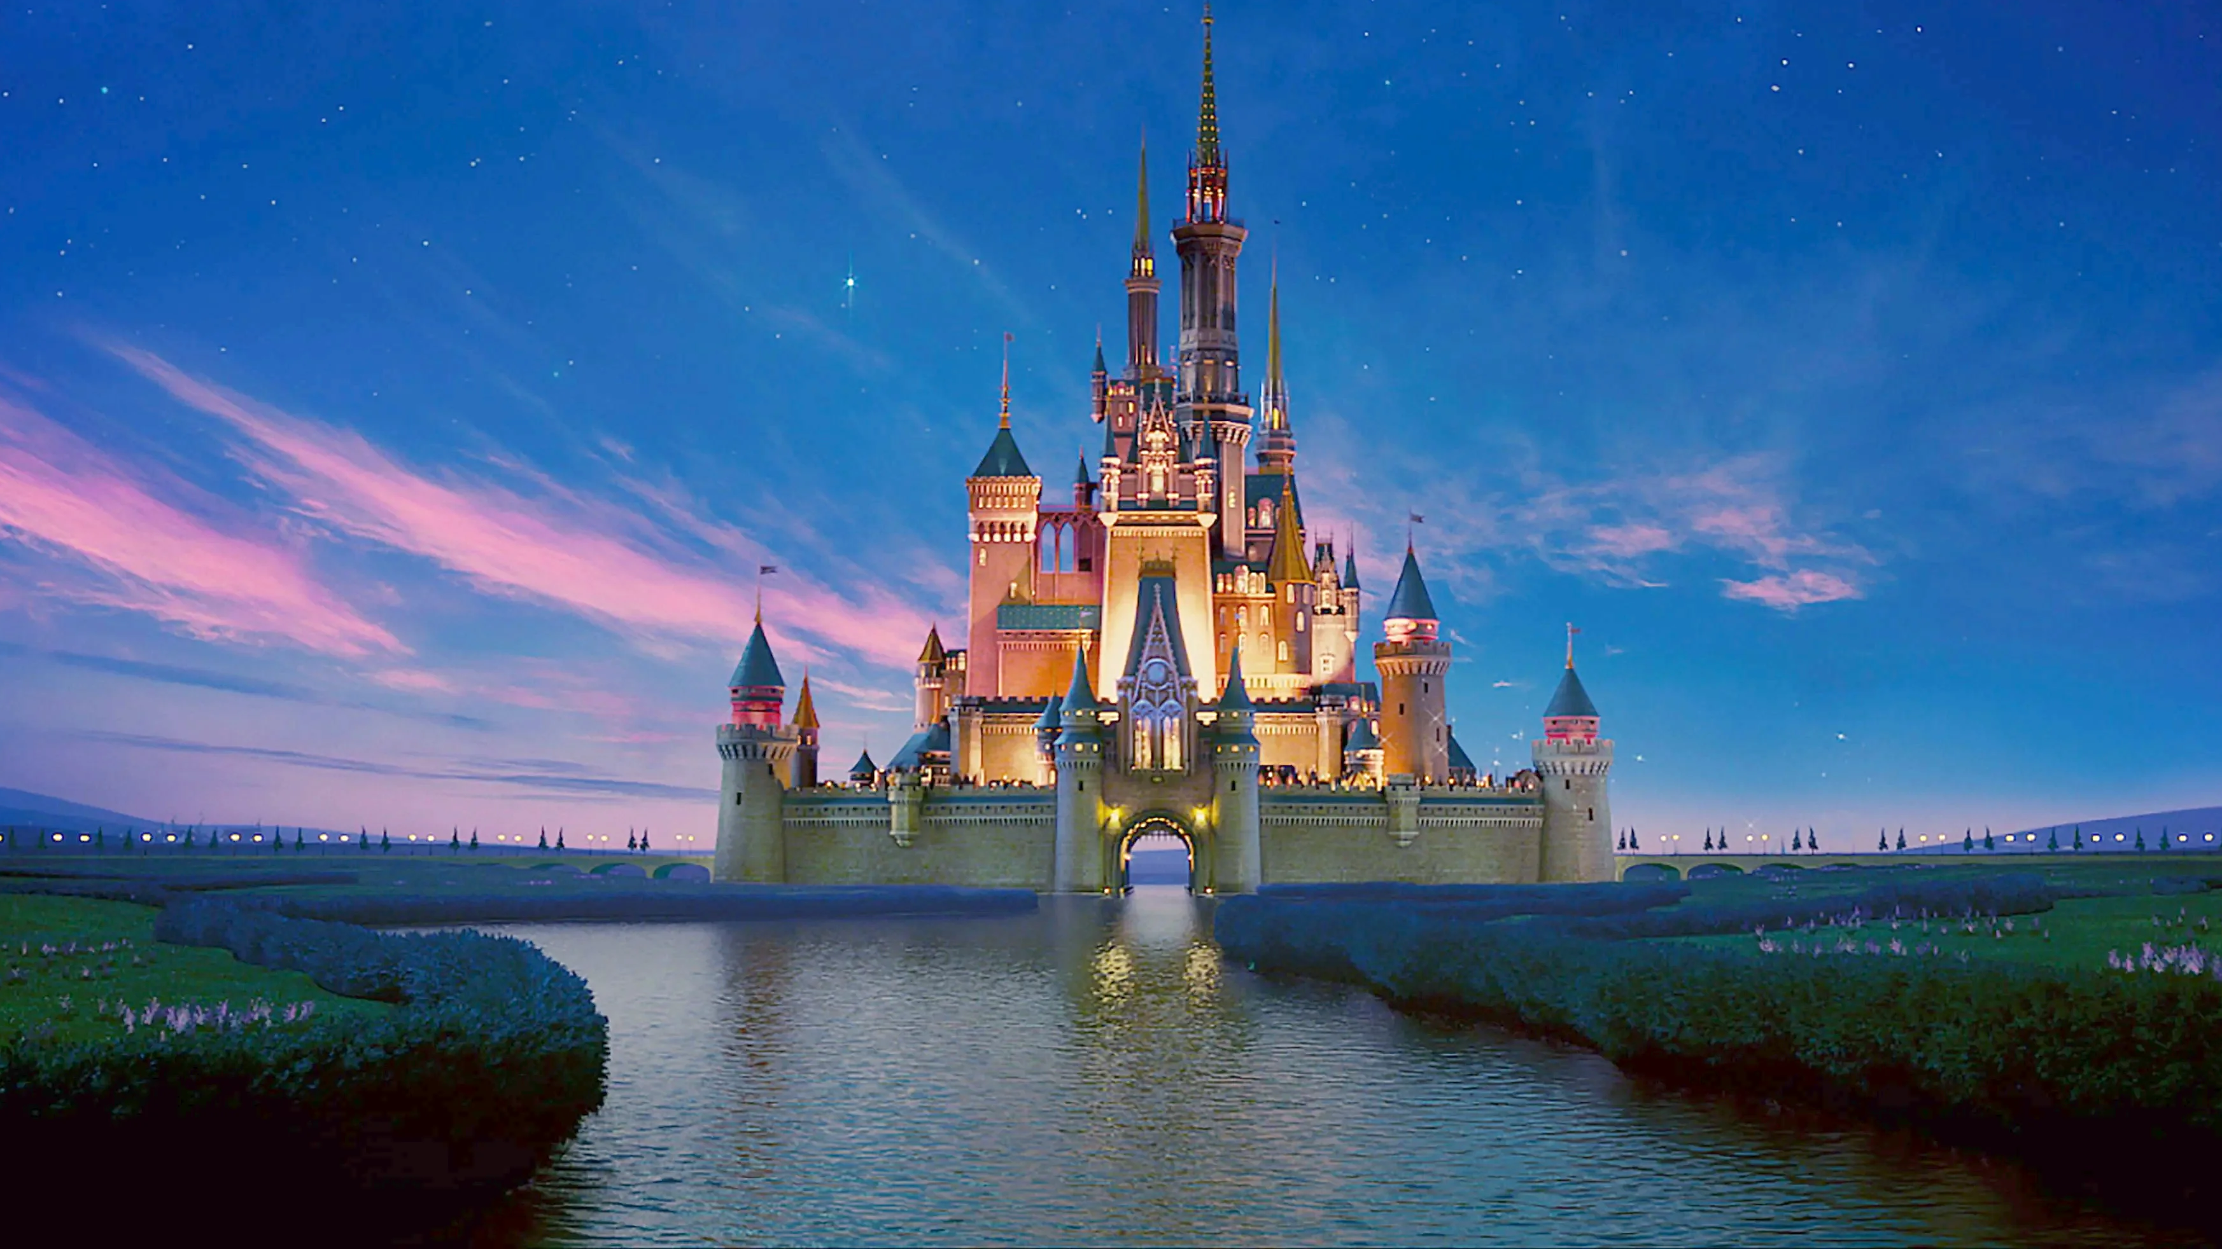
Wheel of Fortune!
Disney

Slide 2
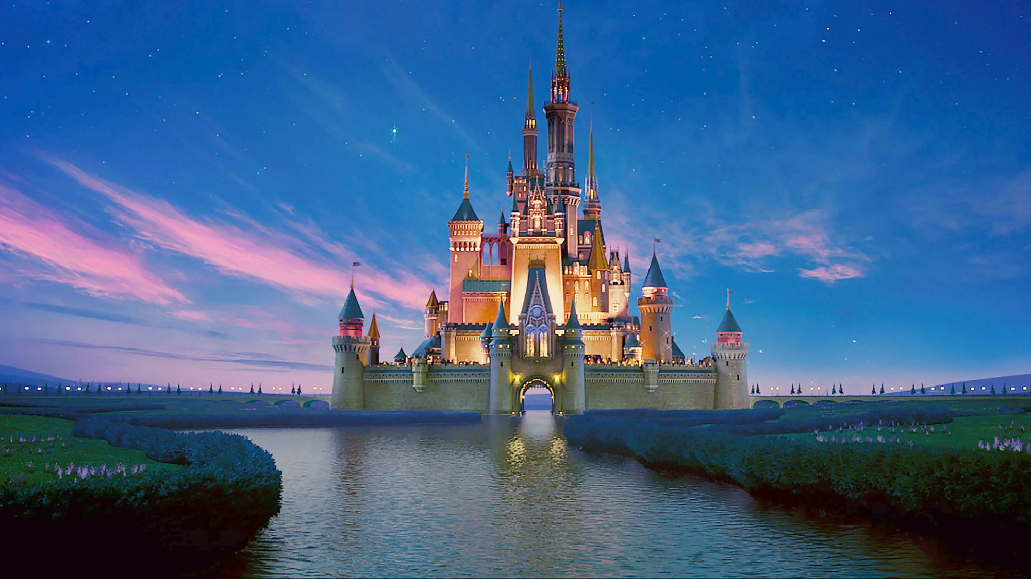
Category: Lion King
H
A
K
U
N
A
M
A
T
A
T
A

Slide 3
Category: Moana
H
O
W
F
A
R
I
‘
L
L
G
O

Slide 4
Category: Beauty & the Beast
B
E
O
U
R
G
U
E
S
T

Slide 5
Category: Tangled
I
S
E
E
T
H
E
L
I
G
H
T

Slide 6
Category: Little Mermaid
U
N
D
E
R
T
H
E
S
E
A

Slide 7
Category: Hercules
Z
E
R
O
T
O
H
E
R
O

